Slide 1
MDI FINANCE
Investment presentation

Slide 2

Group and business profile
Why
Sri Lanka?
Mobile app based, digital lending business managed by highly experienced industry professionals.
MDI Finance group in Sri Lanka owns a lending platform and loan originator with a single product - consumer digital loans with up to a thirty-day term.
Key decision making, supervision and reporting is done from Riga, Latvia with top management base.
The highly experienced team has a one country focus.
Low competition
Minor local regulation requirements with a positive effect on pricing and the actual product
A large share of non-banking clients
Online process with a legal distance customer loan agreement
Straightforward legal setup

Slide 3
Country profile
Country Comparison for the Protection of Investors
Region: Southern Asia, Indian Ocean
Population: ~22 million (2024)
Area: 65,610 square kilometers
Capital: Colombo (executive and judicial); Sri Jayawardenepura Kotte (legislative)
Joined Commonwealth: 1948
Internet Users: 12.34 million (2024)
Active Social Media Users: 8.75 million (2024)
Mobile Connections: 19.43 million (2022)
Active Mobile Social Network Users: ~8.75 million (2024)Languages: English, Sinhala and Tamil
Currency: Sri Lankan rupee (LKR), EUR 1 = LKR 348
9.0
8.0
7.0
6.0
5.0
4.0
Index of Transaction Transparency*
Index of Manager’s Responsibility**
Index of Shareholder’s Power***
Sri Lanka
South Asia
United States
Germany
Source: Doing Business - Latest available data.
Note: *The Greater the Index, the More Transparent Condition of Transactions.
** The Greater the Index, the More the Manager is Personally Responsible.
***The Greater the Index, the Easier it Will Be For Shareholders to Take Legal Action. ****The Greater the Index, the Higher the Level of Investor Protection.

Slide 4
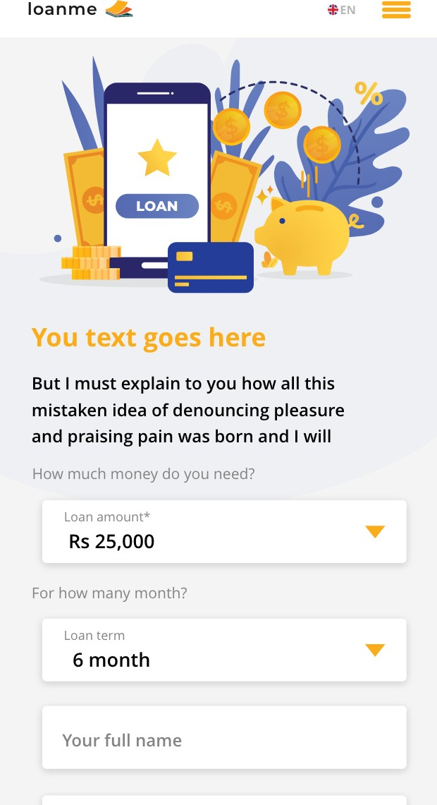
Product
An online platform with an option to add multiple products and loan originators
100% digital consumer loan
Loan amount: minimum 23 EUR, maximum 230 EUR
Average loan size: 64 EUR
Term of 30 days with an option to extend for another 30 days or shorter period
All loans are disbursed via a fully automatic payment getaway directly to a customer bank account
Repayments can also be made through the country’s largest grocery chain – Cargill Food City
supermarkets with 371 locations throughout the country
Monthly percentage for repeated customers: 49%
Website: loanme.lk

Slide 5
Competitive landscape
Five active companies which are direct competition in the digital market at the moment
High customer retention rate: 78%+ customers take a second loan within a month period
Offline lenders do not use the Internet to obtain clients, which gives us the opportunity to acquire customers online at low cost and in a larger scale

Slide 6
Operations overview
Marketing, risk management and debt collection
100% automatized performance marketing tracking
6+ Global affiliate partners managed by own Affiliate platform
77% of new sales done by an in-house campaign management
New and repeated customer in-house developed score card
Multiple external source integrations to identify fraudulent customers
Fully digitalized operations tracking with automatized reports
72% of all incoming communication handled by Chatbots and smart IVR
The recovery process can be modified without IT
development
Partnerships with external collection agencies and
the local authorities

Slide 7
Age
6000
Who are our clients
5000
Who are our clients
4000
3000
2000
1000
All customers are acquired from Online channels
95% of the customers applied using their mobile device while only 5% used desktop devices
All of our customers have an active bank account
83% of the customers prefer to repay the loans in cash
Loan approval rate for new loans 22% and for the repeated loans 79%
18-27
28-37
38-47
48-57 58-67 >68
All customers are acquired from Online channels
95% of the customers applied using their mobile device while only 5% used desktop devices
All of our customers have an active bank account
83% of the customers prefer to repay the loans in cash
Loan approval rate for new loans 22% and for the repeated loans 79%
Gender
Employment type
25,60%
74,40%
Male
Female
Worker
Lawlitigation
Manager
Medic or related
Police
Self Employed
Senior Manager
Unemployed

Slide 8
Future perspectives
Financial highlights revenue and net portfolio
Rapid Market Growth: Sri Lanka’s online lending market is projected to reach LKR 15 billion by 2024*, up from LKR 381 million in 2021, driven by increasing internet and smartphone penetration (over 30 million mobile connections, 85% smartphone connections by 2024
Economic Recovery: Sri Lanka’s economy grew 5% in 2024, with strong tourism (38% increase) and remittances supporting a current account surplus, signaling stability for investors*.
Regulatory Compliance and Licensing Advantage: We are actively collaborating with local authorities to secure licensing under the forthcoming Financial Services Regulatory Authority law, expected in 2025, granting access to enhanced credit evaluation data and stronger loan enforcement powers, significantly reducing risk and boosting investor confidence.
Strategic Retail Financing Product Launch: In partnership with leading local retailers, we are launching a point-of-sale financing product in Q2 2025, enabling instant credit for consumer purchases, tapping into Sri Lanka’s growing retail sector and boosting loan volumes by an estimated 25%
EUR | 2024 | 6m 2025 | 2025* forecast
REVENUE | 1 436 919 | 1 055 417 | 2 089 338
DIRECT COSTS | (757 115) | (611 051) | (1 132 201)
GROSS PROFIT | 679 804 | 444 366 | 957 137
Indirect costs | (431 545) | (273 997) | (522 116)
EBITDA | 402 923 | 140 138 | 344 729
Net Profit / (Loss) | 120 116 | 27 799 | 149 652
Net Loan portfolio | 612 073 | 797 421 | 1 063 616
Notes:
The data is presented without the Forex effect, and the final calculation will be based on the annual closings.
*https://www.siliconindia.com/news/general/the-future-of-finance-trends-in-online-lending-in-sri-lanka-nid-227937-cid-1.html
*https://www.worldbank.org/en/country/srilanka/publication/sri-lanka-development-update-2025

Slide 9
The information in this presentation has not been independently verified and is subject to updating, completion, revision and further amendment.
The presentation does not purport to contain all information that a prospective lender may require. While the information contained herein has been prepared in good faith, neither the Borrower nor its shareholders, directors, officers, agents, employees, or advisors, give, has given or has authority to give, any representations or warranties (expressed or implied) as to, or in relation to, the accuracy, reliability or completeness of the information in this presentation or any revision thereof, or of any other written or oral information made or to be made available to any interested party or its advisors (all such information being referred to as information) and liability therefore is expressly disclaimed save by each person in respect of their own fraud. Accordingly, the Borrower and its shareholders, directors, officers, agents, employees or advisors do not take any responsibility for, and will not accept any liability whether direct or indirect, expressed or implied, contractual, statutory or otherwise, in respect of the accuracy or completeness of the information or for any of the opinions contained herein or for any errors, omissions or misstatements or for any loss, how so ever arising from the use of this presentation.
Information contained in this presentation is confidential information and the property of the Borrower. It is made available strictly for the purposes referred to above. The presentation and any further confidential information made available to any recipient must be held in complete confidence and documents containing such information may not be reproduced, used or disclosed without the prior written consent of the Borrower. This presentation shall not be copied, published, reproduced or distributed in whole or in part at any time without the prior written consent of the Borrower. By accepting delivery of this presentation, the recipient agrees to return it to the Borrower at the request of the Borrower.
This presentation should not be considered as the giving of investment advice by the Borrower or any of its shareholders, directors, officers, agents, employees or advisors. Each party to whom this presentation is made available must make its own independent assessment of the Borrower after making such investigations and taking such advice as may be deemed necessary. In particular, any estimates or projections or opinions contained herein necessarily involve significant elements of subjective judgment, analysis and assumption and each recipient should satisfy itself in relation to such matters. Neither the issue of this presentation nor any part of its contents is to be taken as any form of commitment on the part of the Borrower to proceed with any transaction nor is the right reserved to terminate any discussions or negotiations with any prospective lenders. In no circumstances will the Borrower be responsible for any costs, losses or expenses incurred in connection with any appraisal or investigation of the Borrower.
This presentation does not constitute, or form part of, any offer or invitation to sell or issue, or any solicitation of any offer to subscribe for or purchase any securities in the Borrower, nor shall it, or the fact of its distribution, form the basis of, or be relied upon in connection with, or act as any inducement to enter into, any contractor commitment whatsoever with respect to such securities. The Borrower assumes that the recipient has professional experience and is a high-net worth individual or Borrower this presentation has not been approved as any governmental agency.
By accepting this presentation, the recipient represents and warrants that it is a person to whom this presentation may be delivered or distributed without a violation of the laws of any relevant jurisdiction. This presentation is not to be disclosed to any other person or used for any other purpose and any other person who receives this presentation should not rely or act upon it. Neither the Borrower nor its directors make any recommendation as to the matters set out in the presentation. Prospective lenders interested in investing in the Borrower are recommended to seek their own independent legal, tax and/or financial investment advice from a competent financial advisor. The whole of the presentation should be read. Reliance on this presentation for the purposes of engaging in any investment in the Borrower may expose an individual to a significant risk of losing the entire investment and may not be suitable for all recipients

